Slide 1






DIGITAL TALENT SCHOLARSHIP
2019
digitalent.kominfo.go.id

Slide 2
Deep Learning Models

Slide 3

Recurrent Neural Network
Bagian 1

Slide 4
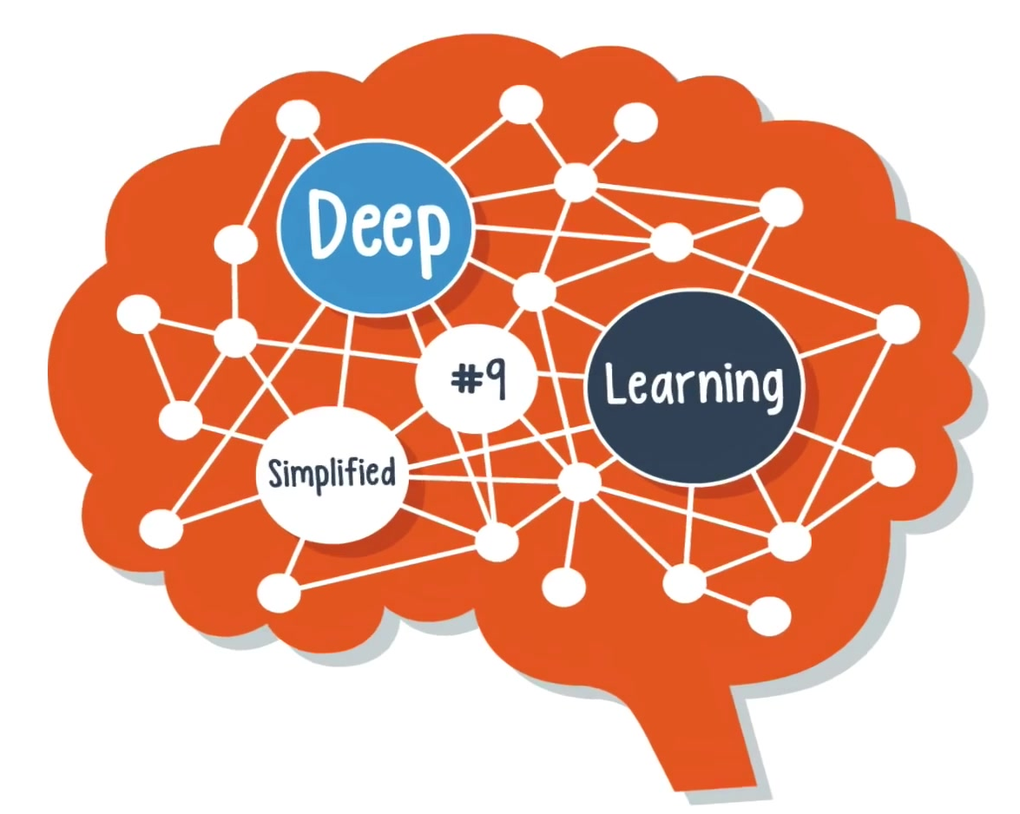
Recurrent Neural Network

Slide 5


What do you do if the patterns in your data change with time?

Slide 6
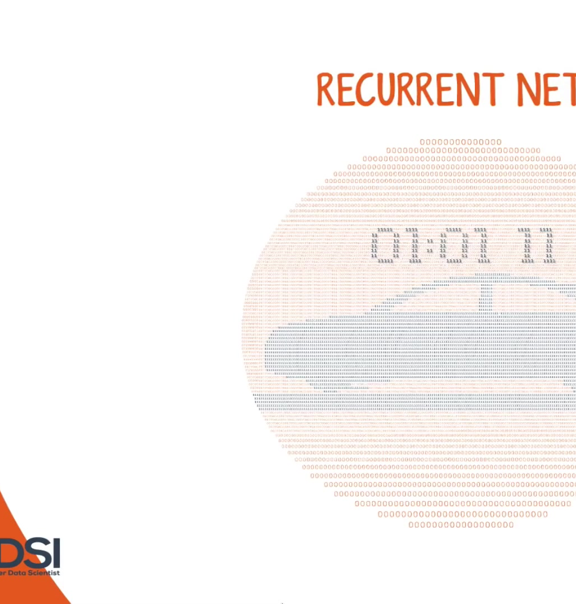
In that case, your best bet is to use a recurrent neural network.
This deep learning model has a simple structure with a built-in feedback loop, allowing it to act as a forecasting engine.

Slide 7
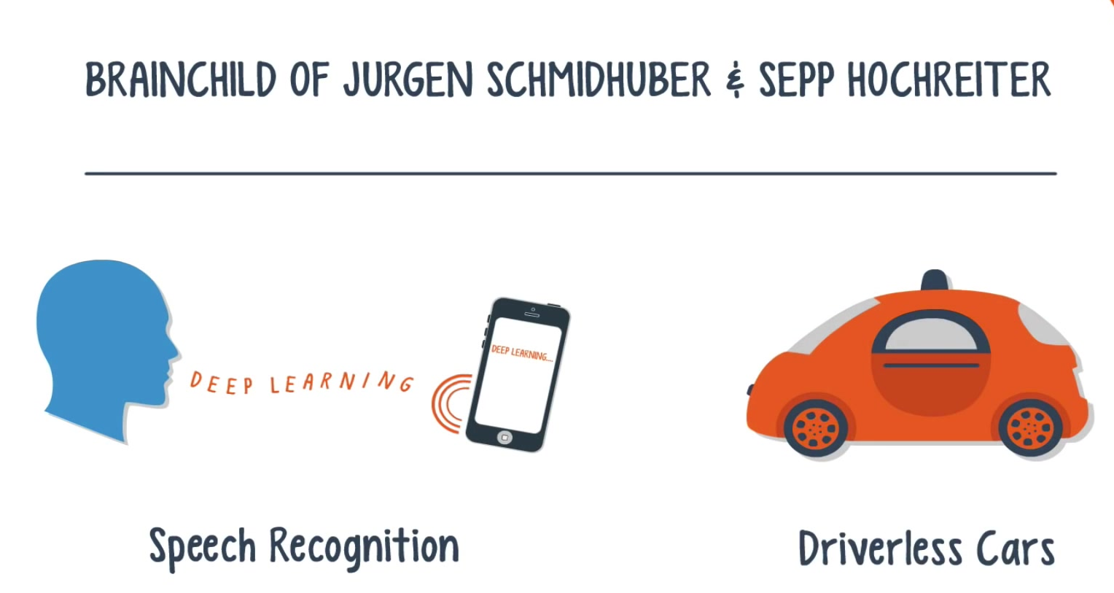
Notes:
Recurrent neural networks, or RNNs, have a long history, but their recent popularity is mostly due to the works of Juergen Schmidhuber, Sepp Hochreiter, and Alex Graves.
Their applications are extremely versatile – ranging from speech recognition to driverless cars.

Slide 8
Recurrent Neural Network
In a feedforward neural network, signals flow in only one direction from input to output, one layer at a time.
In a recurrent net, the output of a layer is added to the next input and fed back into the same layer, which is typically the only layer in the entire network.

Slide 9
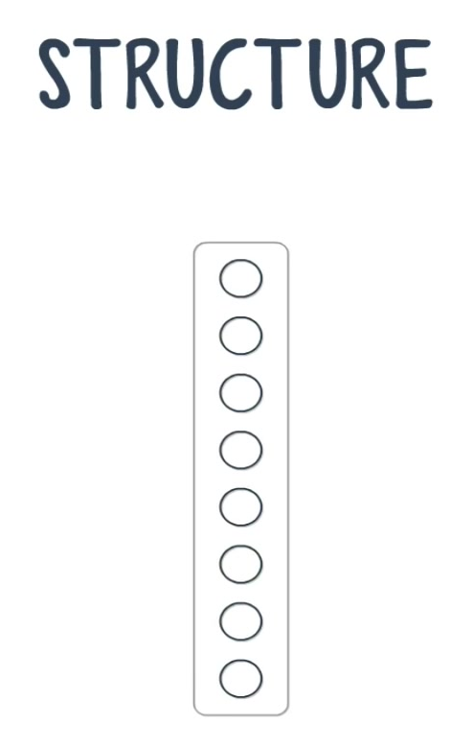
Think of this process as a passage through time

Slide 10

Notes:
shown here are 4 such time steps

Slide 11
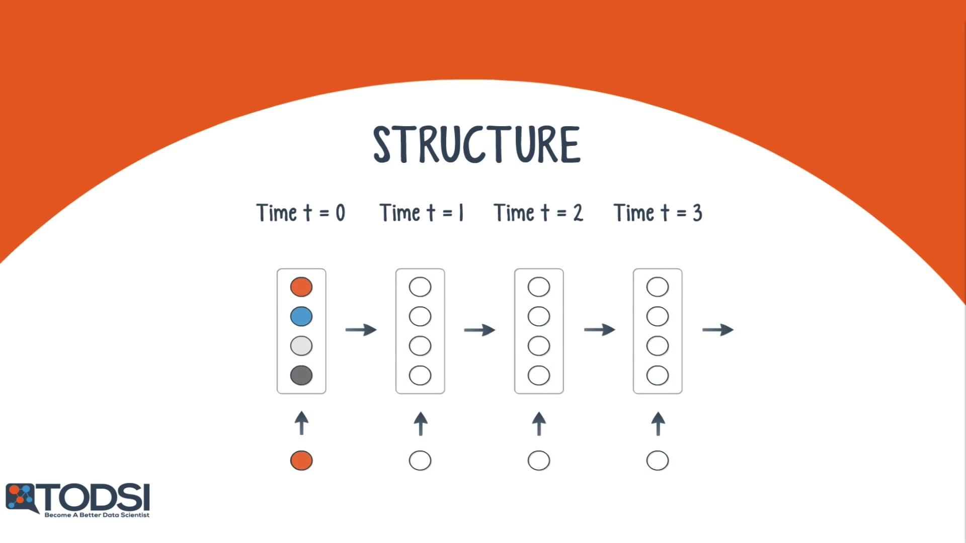
Notes:
At t = 1, the net takes the output of time t = 0 and sends it back into the net along with the next input. The net repeats this for t = 2, t = 3, and so on.

Slide 12
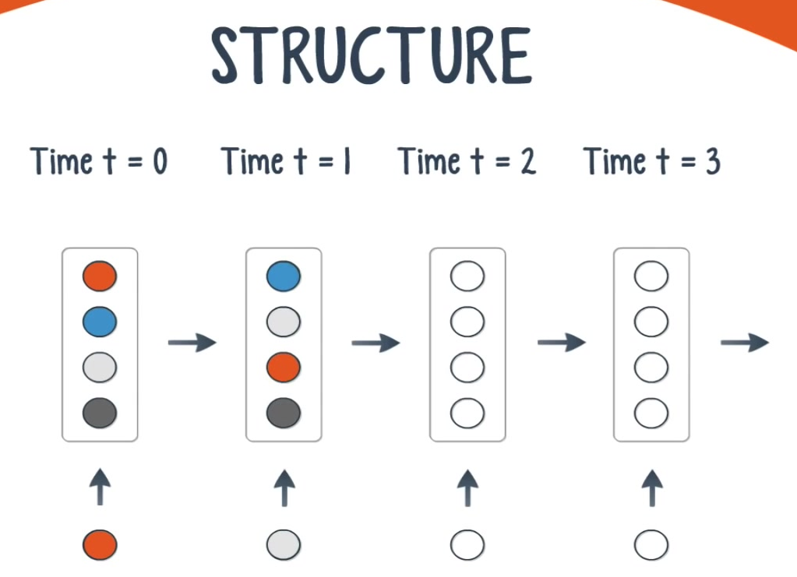

Slide 13


Slide 14
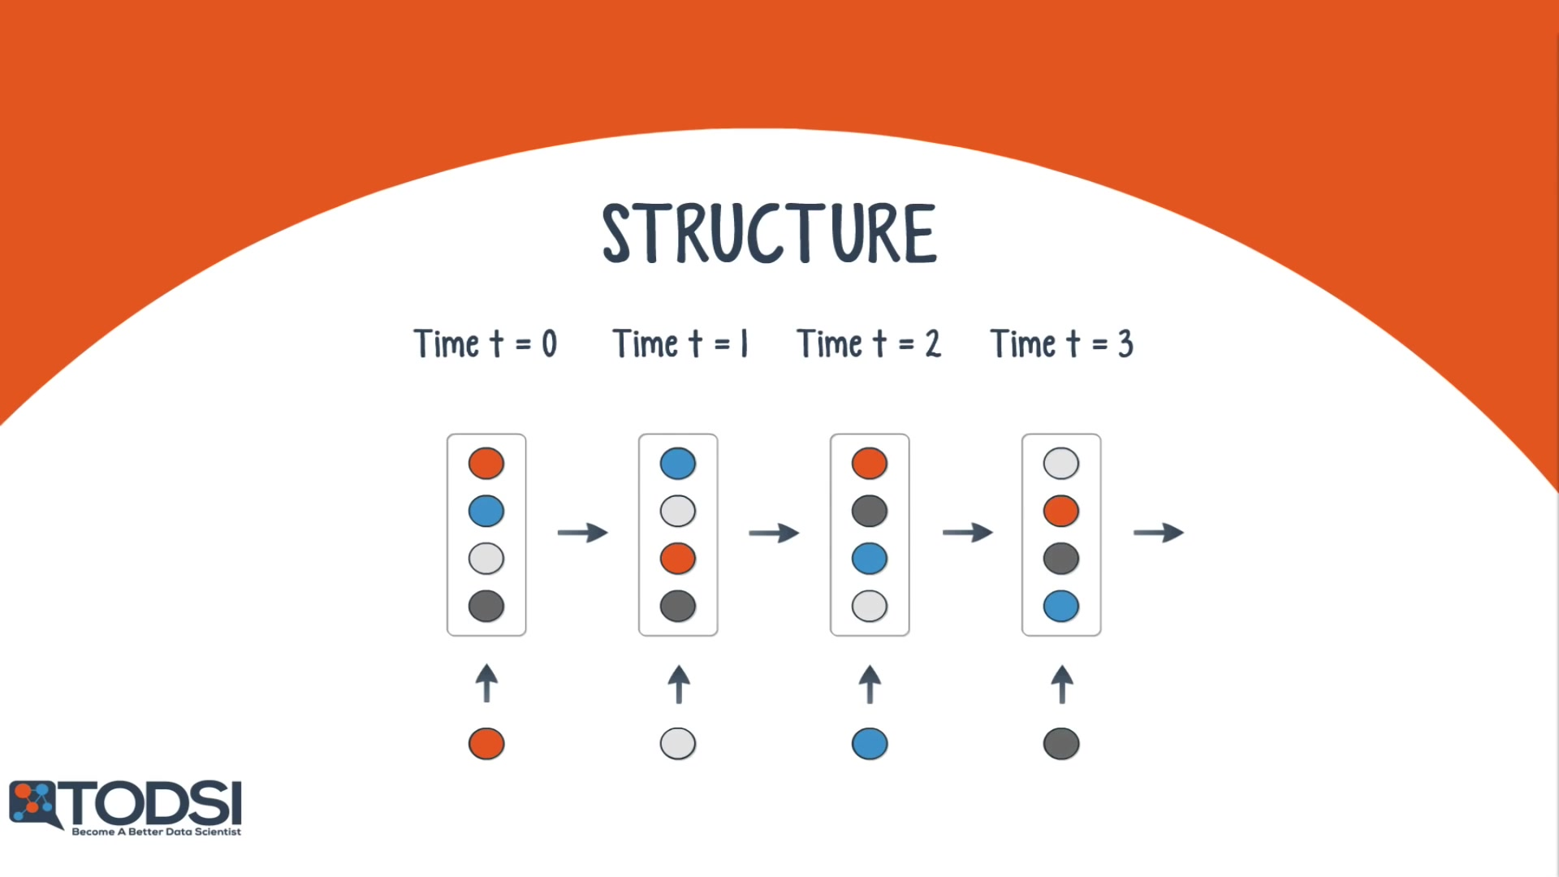

Slide 15
Unlike feedforward nets, a recurrent net can receive a sequence of values as input, and it can also produce a sequence of values as output.
Usage
The ability to operate with sequences opens up these nets to a wide variety of applications

Slide 16
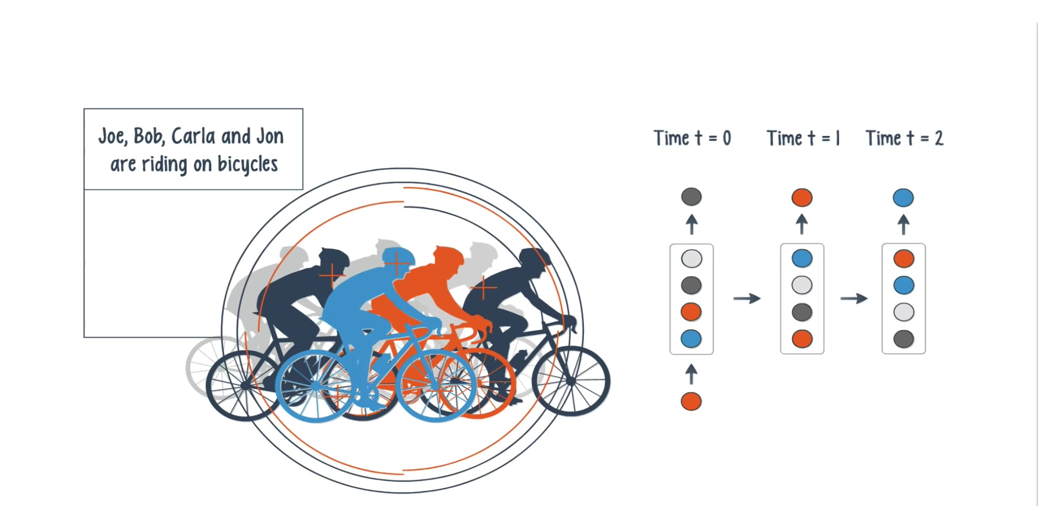
Notes:
When the input is singular and the output is a sequence, a potential application is image captioning.

Slide 17
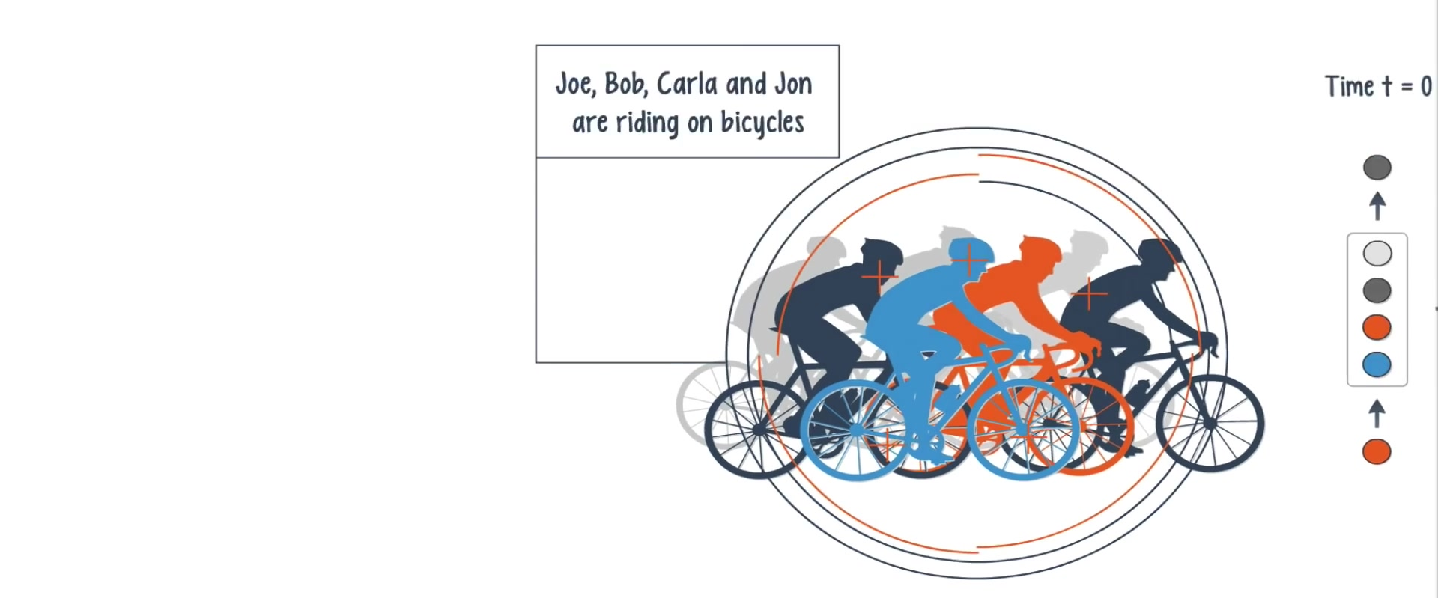

Slide 18
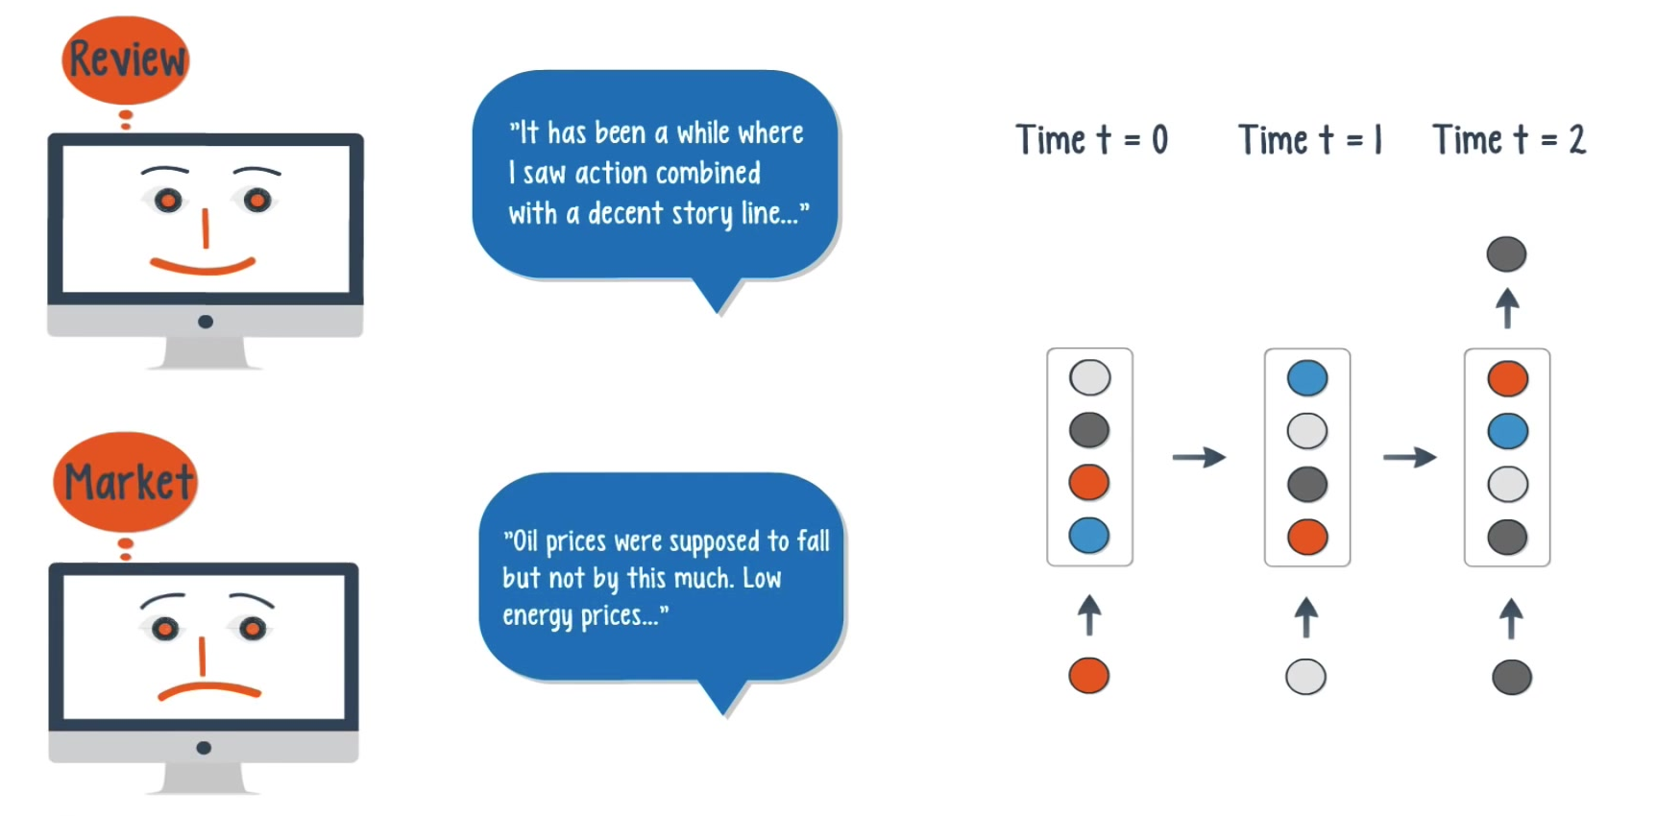
Notes:
A sequence of inputs with a single output can be used for document classification.

Slide 19
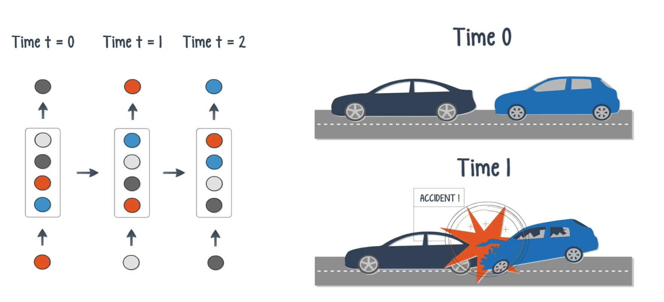
Notes:
When both the input and output are sequences, these nets can classify videos frame by frame.

Slide 20
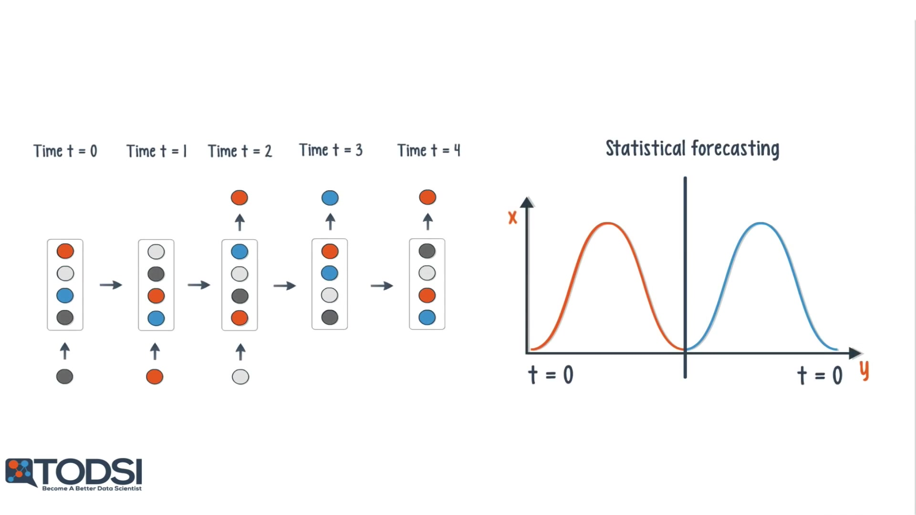
Notes:
If a time delay is introduced, the net can statistically forecast the demand in supply chain planning.

Slide 21
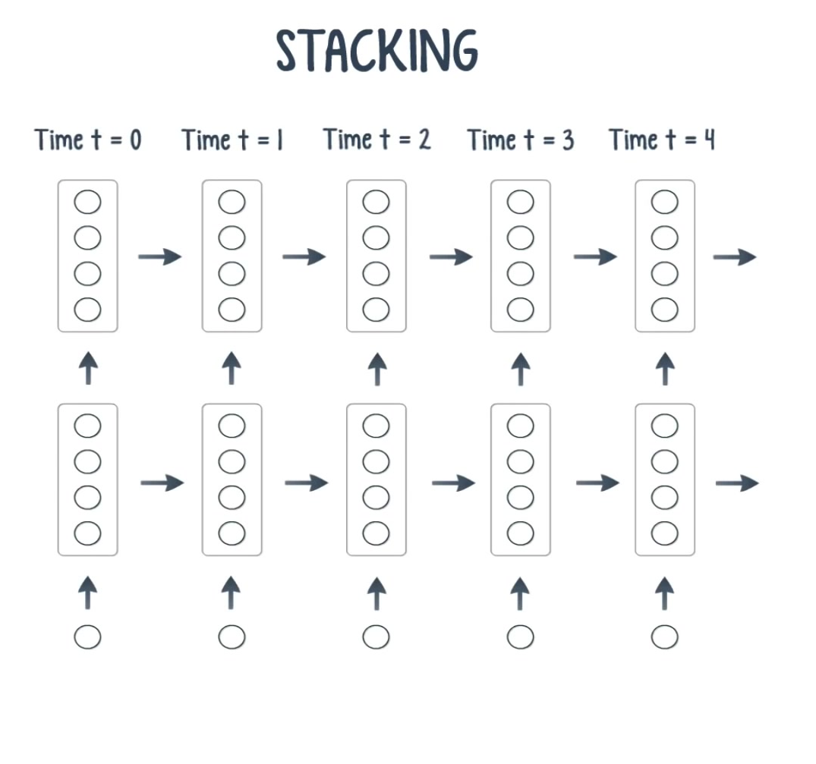
Notes:
with previous deep learning models, by stacking RNNs on top of each other, you can form a net capable of more complex output than a single RNN working alone.

Slide 22
An Old Problem
an RNN is an extremely difficult net to train. Since these nets use backpropagation, we once again run into the problem of the vanishing gradient.
Unfortunately, the vanishing gradient is exponentially worse for an RNN. The reason for this is that each time step

Slide 23
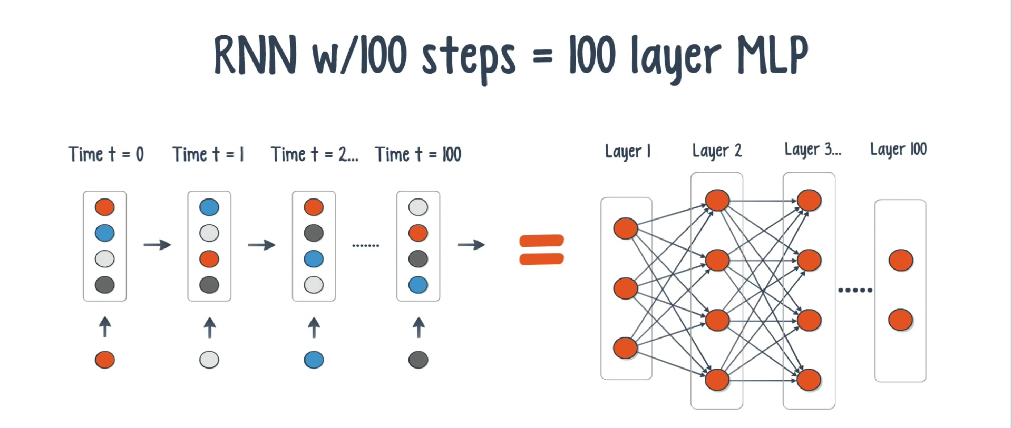
100 time steps is like training a 100-layer feedforward net – this leads to exponentially small gradients

Slide 24
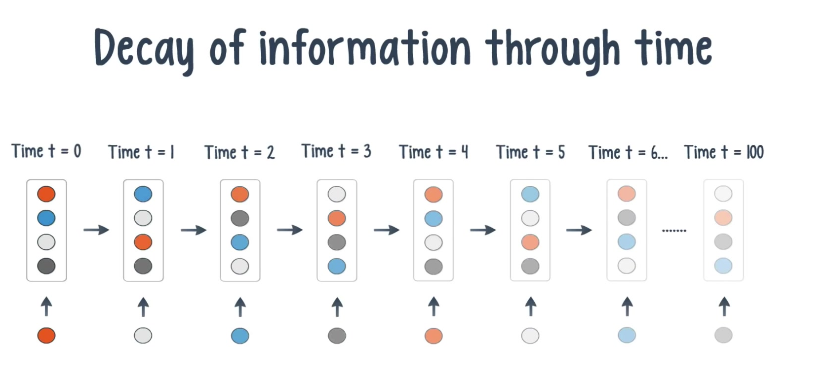
Notes:
and a decay of information through time.

Slide 25

There are several ways to address this problem - the most popular of which is gating.

Slide 26
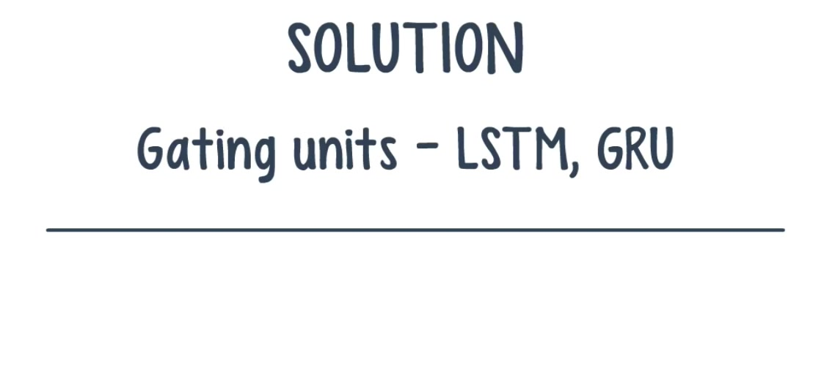
Gating is a technique that helps the net decide when to forget the current input, and when to remember it for future time steps.

Slide 27
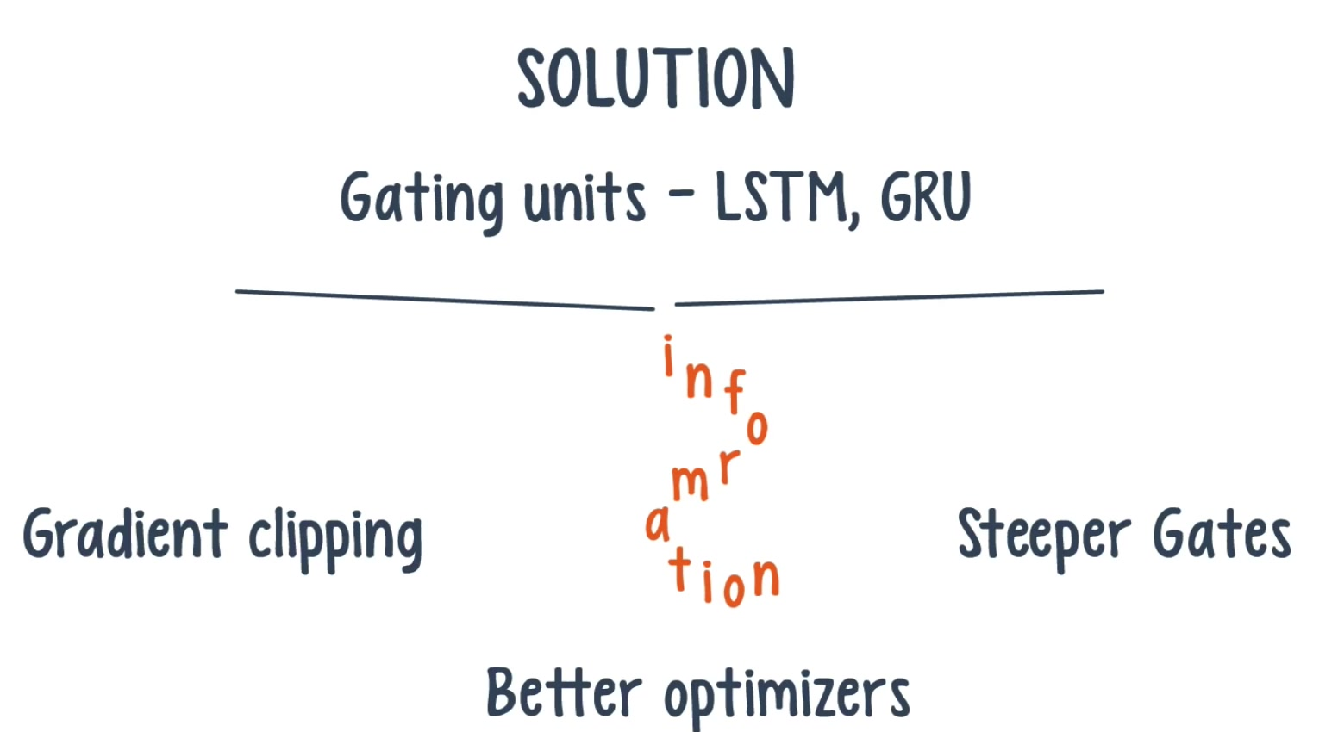
Notes:
The most popular gating types today are GRU and LSTM.
Besides gating, there are also a few other techniques like gradient clipping, steeper gates, and better optimizers.

Slide 28
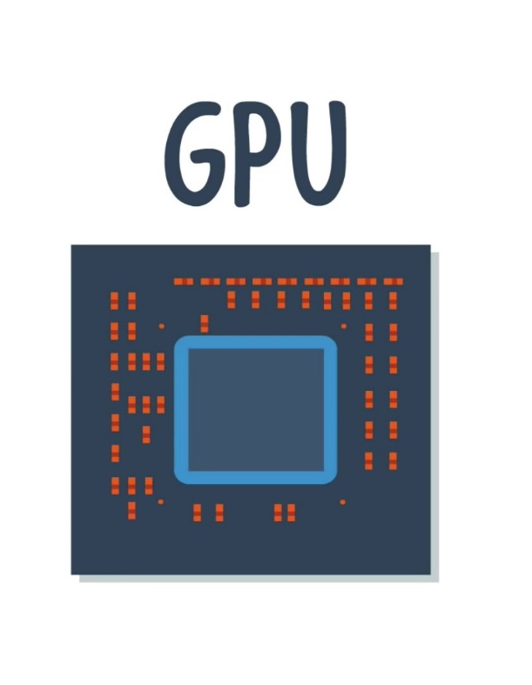
The team found that GPUs were able to train the nets 250 times faster!
Notes:
When it comes to training a recurrent net, GPUs are an obvious choice over an ordinary CPU. This was validated by a research team at Indico, which uses these nets on text processing tasks like sentiment analysis and helpfulness extraction.

Slide 29
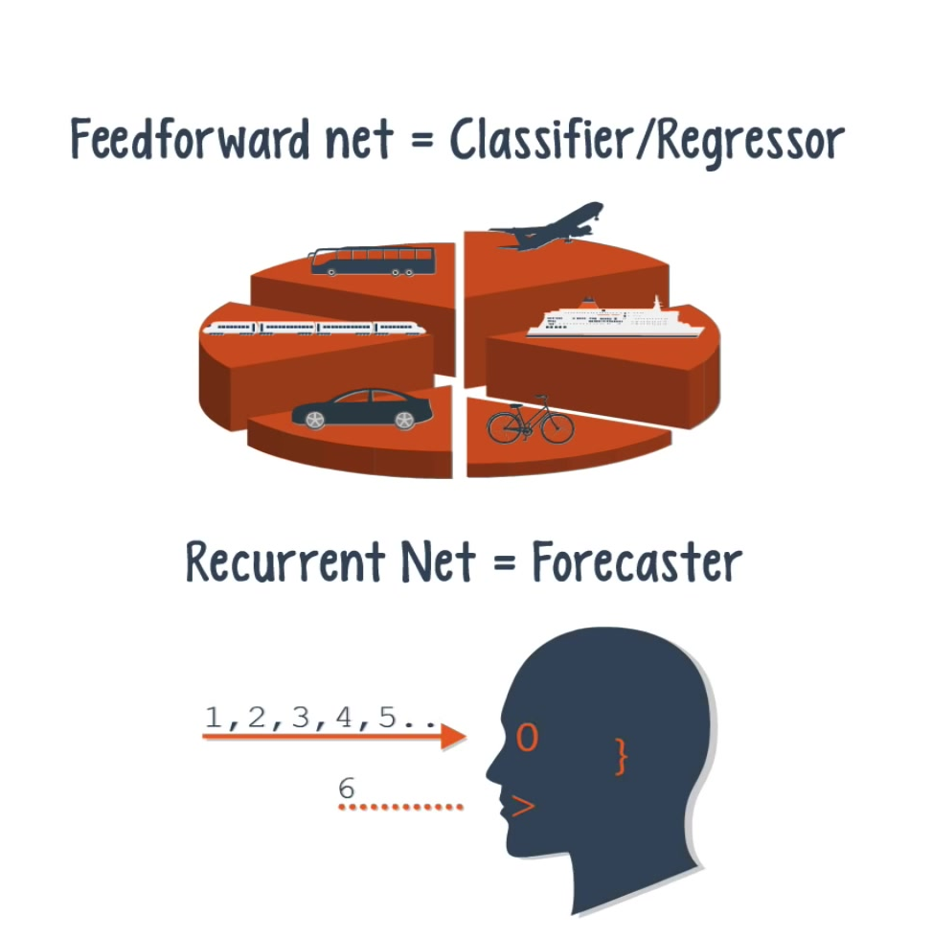
A recurrent net is suited for time series data, where an output can be the next value in a sequence, or the next several values.
Notes:
So under what circumstances would you use a recurrent net over a feedforward net? We
know that a feedforward net outputs one value, which in many cases was a class or a prediction.
So the answer depends on whether the application
calls for classification, regression, or forecasting.

Slide 30
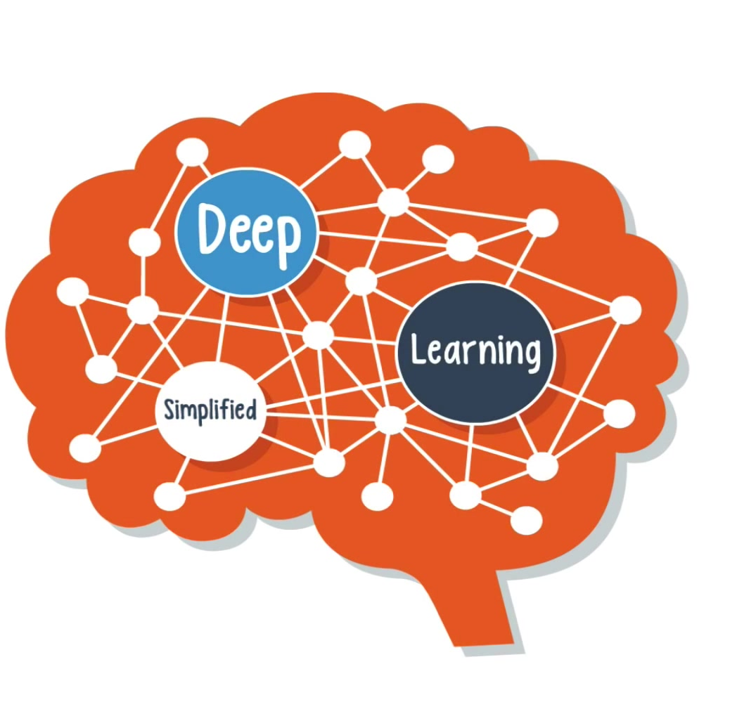

Slide 31





IKUTI KAMI
digitalent.kominfo
digitalent.kominfo
DTS_kominfo
Digital Talent Scholarship 2019
Pusat Pengembangan Profesi dan Sertifikasi
Badan Penelitian dan Pengembangan SDM
Kementerian Komunikasi dan Informatika
Jl. Medan Merdeka Barat No. 9
(Gd. Belakang Lt. 4 - 5)
Jakarta Pusat, 10110
digitalent.kominfo.go.id

